Slide 1
Lecture 22 Confidence Level, Critical Value, and Making Decisions

Slide 2
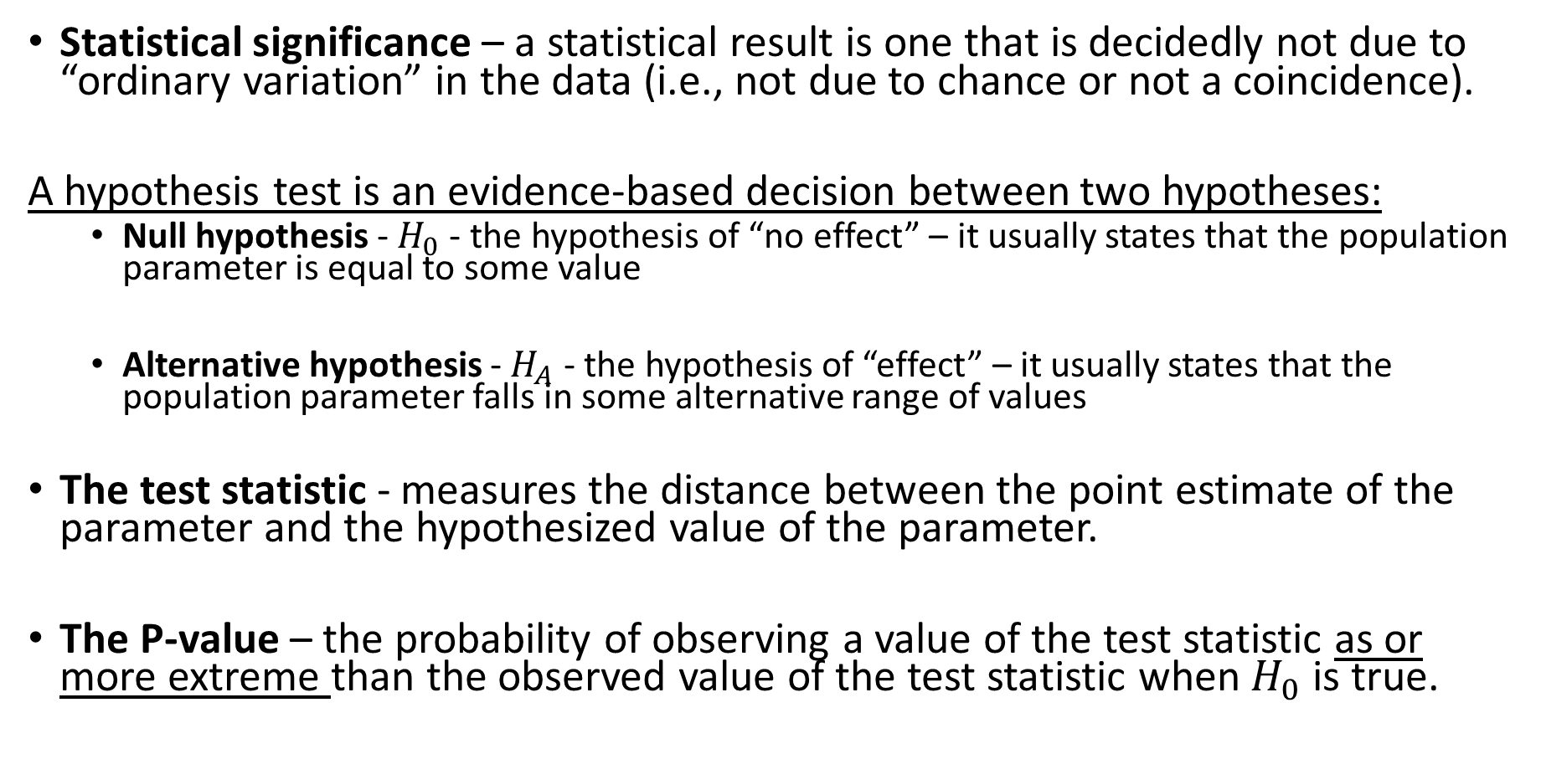
Review From Monday
Statistical significance – a statistical result is one that is decidedly not due to “ordinary variation” in the data (i.e., not due to chance or not a coincidence).
A hypothesis test is an evidence-based decision between two hypotheses:
Null hypothesis - $H_{0}$ - the hypothesis of “no effect” – it usually states that the population parameter is equal to some value
Alternative hypothesis - $H_{A}$ - the hypothesis of “effect” – it usually states that the population parameter falls in some alternative range of values
The test statistic - measures the distance between the point estimate of the parameter and the hypothesized value of the parameter.
The P-value – the probability of observing a value of the test statistic as or more extreme than the observed value of the test statistic when $H_{0}$ is true.

Slide 3
Review: The five steps of a hypothesis test
1. Assumptions
2. State the null and alternative hypotheses
3. Compute the test statistic
4. Compute the p-value
5. Make a decision – reject or fail to reject the null
Is the result statistically significant?
How do we decide how significant a result needs to be to reject the null?

Slide 4
Stating Hypotheses

Slide 5
Example 1:
Does taking garlic supplements repel ticks? A study published in the Journal of the American Medical Association used a cross-over experimental design to determine if daily consumption of garlic would reduce tick bites. A total of 66 Swedish military personnel took 1200mg of garlic daily during one period, and a placebo during the other period. 37 subjects reported fewer tick bites during the period they took garlic supplements. Is there evidence that more than 50% of Swedish soldiers experienced fewer tick bites while taking the garlic supplement? Conduct a significance test at the 5% significance level and report your conclusion.

Slide 6
Example 2:
In the city of Las Vegas, by law cars are required to stop for pedestrians trying to cross the street. In practice many drivers do not stop. A study conducted by the University of Nevada, Las Vegas conducted trials by having pedestrians wait at the curb of a midblock crosswalk and observe whether the next car approaching would stop. Out of a total of 126 of such trials, in 76 trials the first car approaching stopped for the pedestrian. Is there evidence that fewer than 75% of drivers actually stop? Conduct a significance test at the 5% significance level and report your conclusion.

Slide 7
Example 3:
A study investigated if dogs could be trained to detect whether a person has lung cancer or breast cancer by smelling the subject's breath. The researchers trained five ordinary household dogs to distinguish, by scent alone, exhaled breath samples of 55 lung and 31 breast cancer patients from those of 83 healthy controls. Once trained, the dogs’ ability to distinguish cancer patients from controls was tested using breath samples from 119 subjects not previously encountered (dogs and handlers were blinded from the treatments to avoid bias). The dogs correctly distinguished between cancer patients and controls for 101 out of 119 subjects. Is there any evidence that the probability of the dogs correctly selecting patients differs from random guessing? Conduct a significance test at the 1% significance level and report your conclusion.

Slide 8
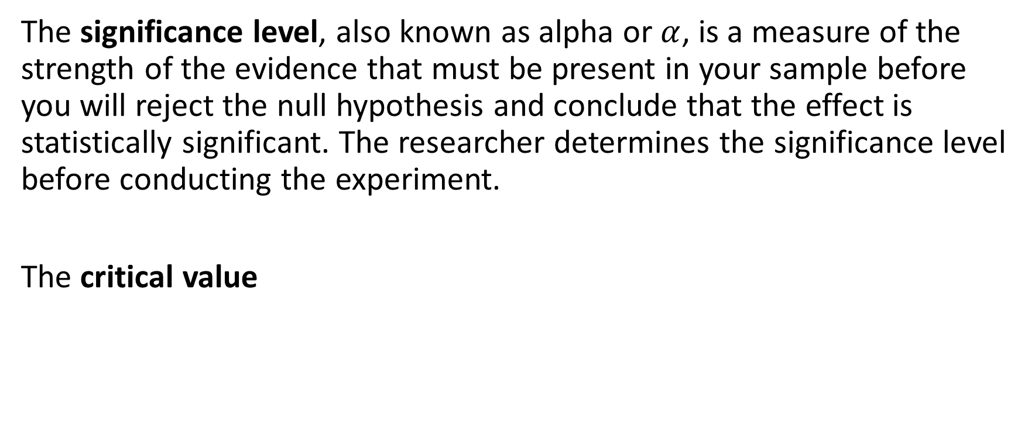

Significance Level $α$ and Critical Value
The significance level, also known as alpha or $α$, is a measure of the strength of the evidence that must be present in your sample before you will reject the null hypothesis and conclude that the effect is statistically significant. The researcher determines the significance level before conducting the experiment.
The critical value

Slide 9
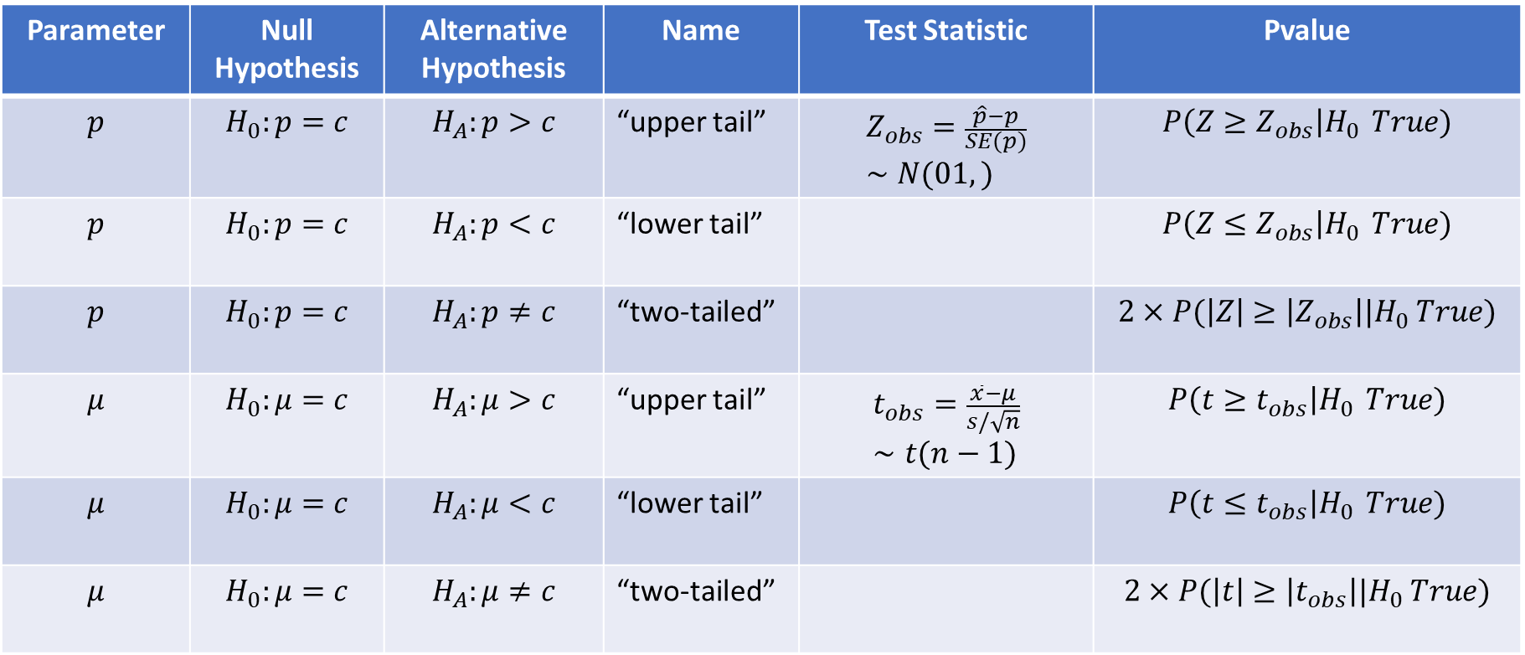
Parameter | Null Hypothesis | Alternative Hypothesis | Name | Test Statistic | Pvalue
$$p$$ | $$H_{0}:p=c$$ | $$H_{A}:p>c$$ | “upper tail” | $$Z_{obs}=\frac{\hat{p}−p}{SE(p)}∼N(01,)$$ | $$P\left(Z≥Z_{obs}\right|H_{0 } True)$$
$$p$$ | $$H_{0}:p=c$$ | $$H_{A}:p<c$$ | “lower tail” |  | $$P\left(Z≤Z_{obs}\right|H_{0 } True)$$
$$p$$ | $$H_{0}:p=c$$ | $$H_{A}:p≠c$$ | “two-tailed” |  | $$2×P(\left|Z\right|≥\left|Z_{obs}\right||H_{0} True)$$
$$μ$$ | $$H_{0}:μ=c$$ | $$H_{A}:μ>c$$ | “upper tail” | $$t_{obs}=\frac{\overline{x}−μ}{s/\sqrt{n}}∼t(n−1)$$ | $$P\left(t≥t_{obs}\right|H_{0 } True)$$
$$μ$$ | $$H_{0}:μ=c$$ | $$H_{A}:μ<c$$ | “lower tail” |  | $$P\left(t≤t_{obs}\right|H_{0 } True)$$
$$μ$$ | $$H_{0}:μ=c$$ | $$H_{A}:μ≠c$$ | “two-tailed” |  | $$2×P(\left|t\right|≥\left|t_{obs}\right||H_{0} True)$$

Slide 11
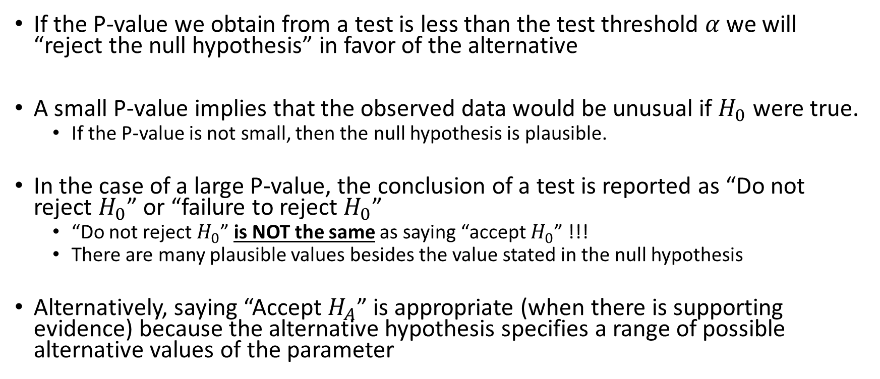
Interpreting Results Of A Significance Test
If the P-value we obtain from a test is less than the test threshold $α$ we will “reject the null hypothesis” in favor of the alternative
A small P-value implies that the observed data would be unusual if $H_{0}$ were true.
If the P-value is not small, then the null hypothesis is plausible.
In the case of a large P-value, the conclusion of a test is reported as “Do not reject $H_{0}$” or “failure to reject $H_{0}$”
“Do not reject $H_{0}$” is NOT the same as saying “accept $H_{0}$” !!!
There are many plausible values besides the value stated in the null hypothesis
Alternatively, saying “Accept $H_{A}$” is appropriate (when there is supporting evidence) because the alternative hypothesis specifies a range of possible alternative values of the parameter

Slide 12
Deciding between One-Sided and Two-Sided Tests
A one-sided test implies we have some information about the direction of the effect (i.e the effect is lesser or greater)
A two-sided test allows the effect to be in either direction.
Things to consider:
The context of the question (“more than”, “less than”, “different”)
Most research articles use two-sided tests – this represents an objective approach to conducting research
Two-sided tests are essentially confidence intervals which are also two-sided

Slide 13
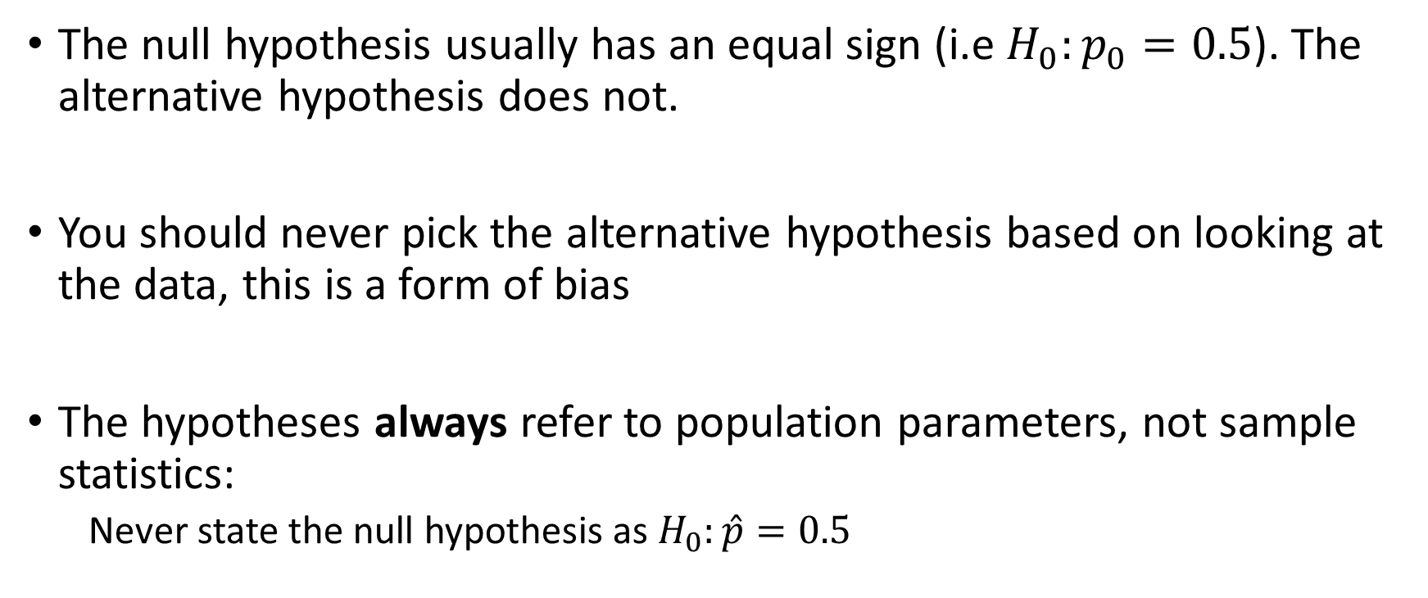
Technical Points of Significance Tests
The null hypothesis usually has an equal sign (i.e $H_{0}:p_{0}=0.5$). The alternative hypothesis does not.
You should never pick the alternative hypothesis based on looking at the data, this is a form of bias
The hypotheses always refer to population parameters, not sample statistics:
Never state the null hypothesis as $H_{0}:\hat{p}=0.5$

Slide 14
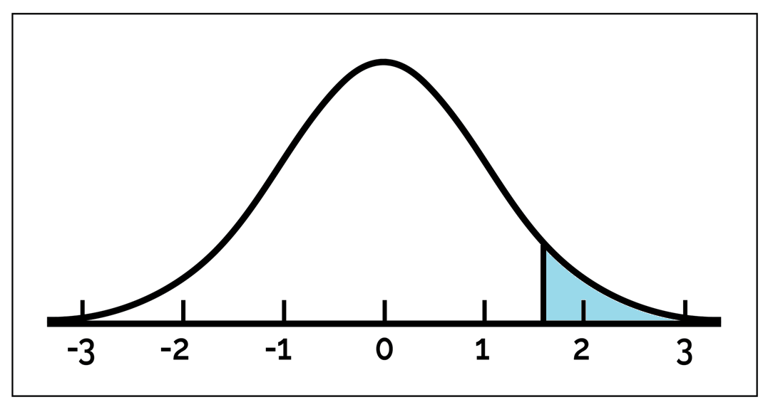

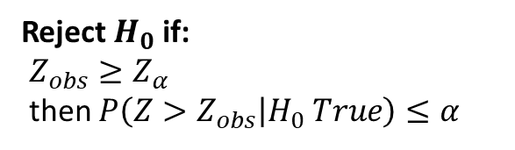



$$α=P\left(Z≥Z_{α}\right)$$
Rejection Region = $[Z_{α}, ∞)$
Reject $H_{0}$ if:
$Z_{obs}≥Z_{α}$
then $P\left(Z>Z_{obs} | H_{0} True\right)≤α$
Do Not Reject
$$H_{0}$$
$$Z_{α}$$

Slide 15
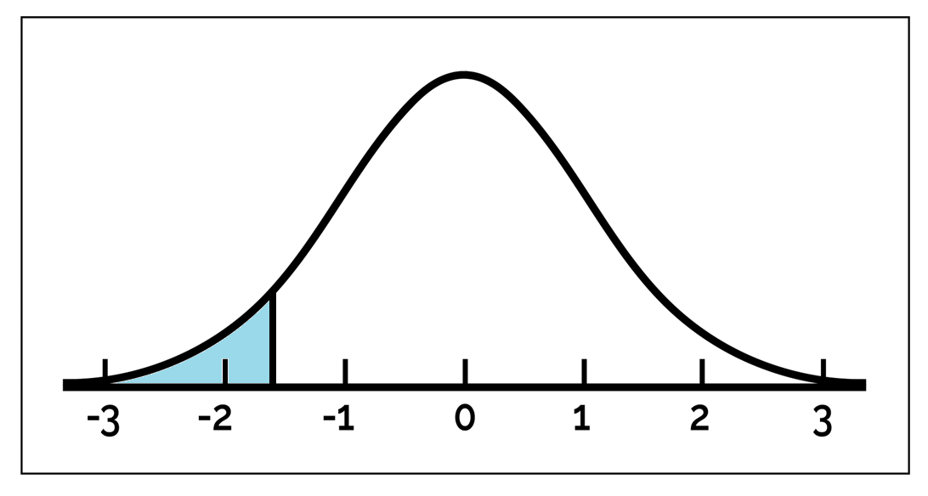

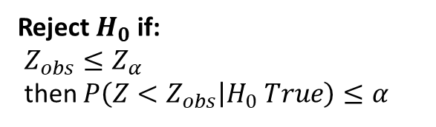


$$α=P\left(Z≤Z_{α}\right)$$
Rejection Region = $(−∞, Z_{α}]$
Reject $H_{0}$ if:
$Z_{obs}≤Z_{α}$
then $P\left(Z<Z_{obs} | H_{0} True\right)≤α$
Do Not Reject
$$H_{0}$$
$$Z_{α}$$

Slide 16
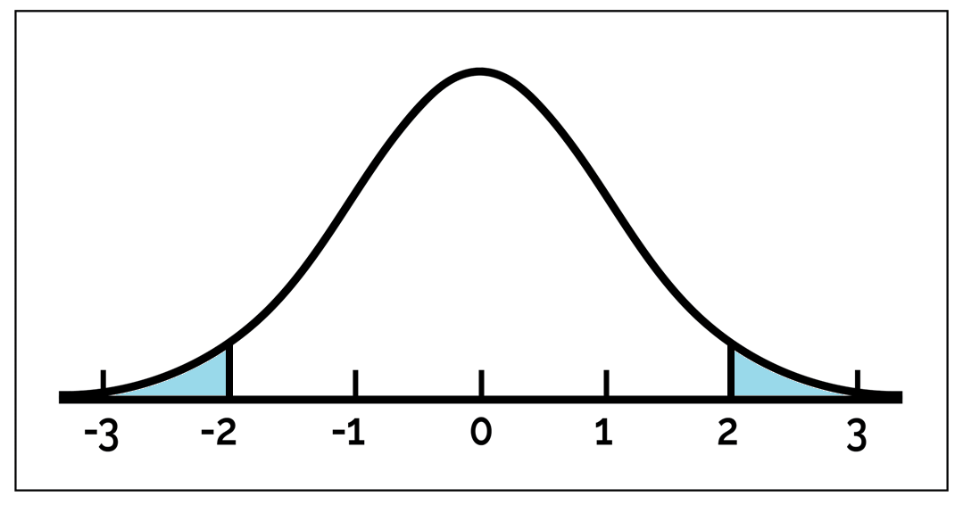
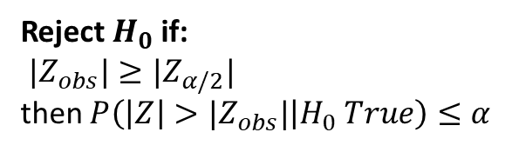





$$α=P\left(|Z|≥|Z_{α}|\right)$$
Rejection Region = $(−∞, {−Z}_{α/2}]$ and $[Z_{α/2}, ∞)$
Reject $H_{0}$ if:
${|Z}_{obs}|≥|Z_{α/2}|$
then $P\left(\left|Z\right|>|Z_{obs}| | H_{0} True\right)≤α$
Do Not Reject
$$H_{0}$$
$${−Z}_{α/2}$$
$$Z_{α/2}$$

Slide 17
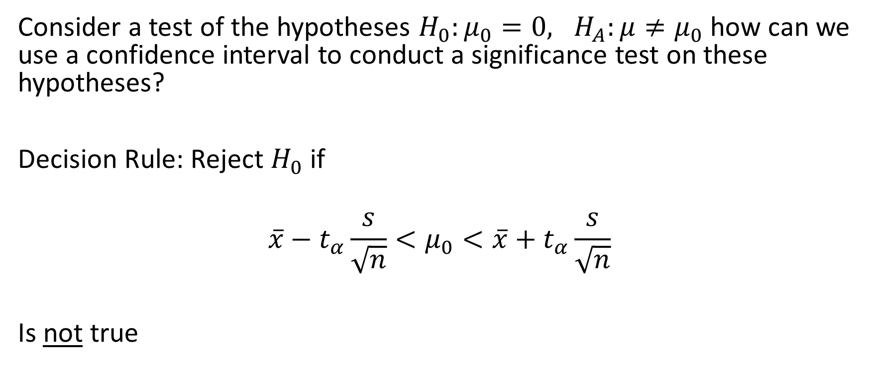
Relationship between significance tests and confidence intervals
Consider a test of the hypotheses $H_{0}:μ_{0}=0, H_{A}:μ≠μ_{0}$ how can we use a confidence interval to conduct a significance test on these hypotheses?
Decision Rule: Reject $H_{0}$ if
$$\overline{x}−t_{α}\frac{s}{\sqrt{n}}<μ_{0}<\overline{x}+t_{α}\frac{s}{\sqrt{n}}$$
Is not true

Slide 18
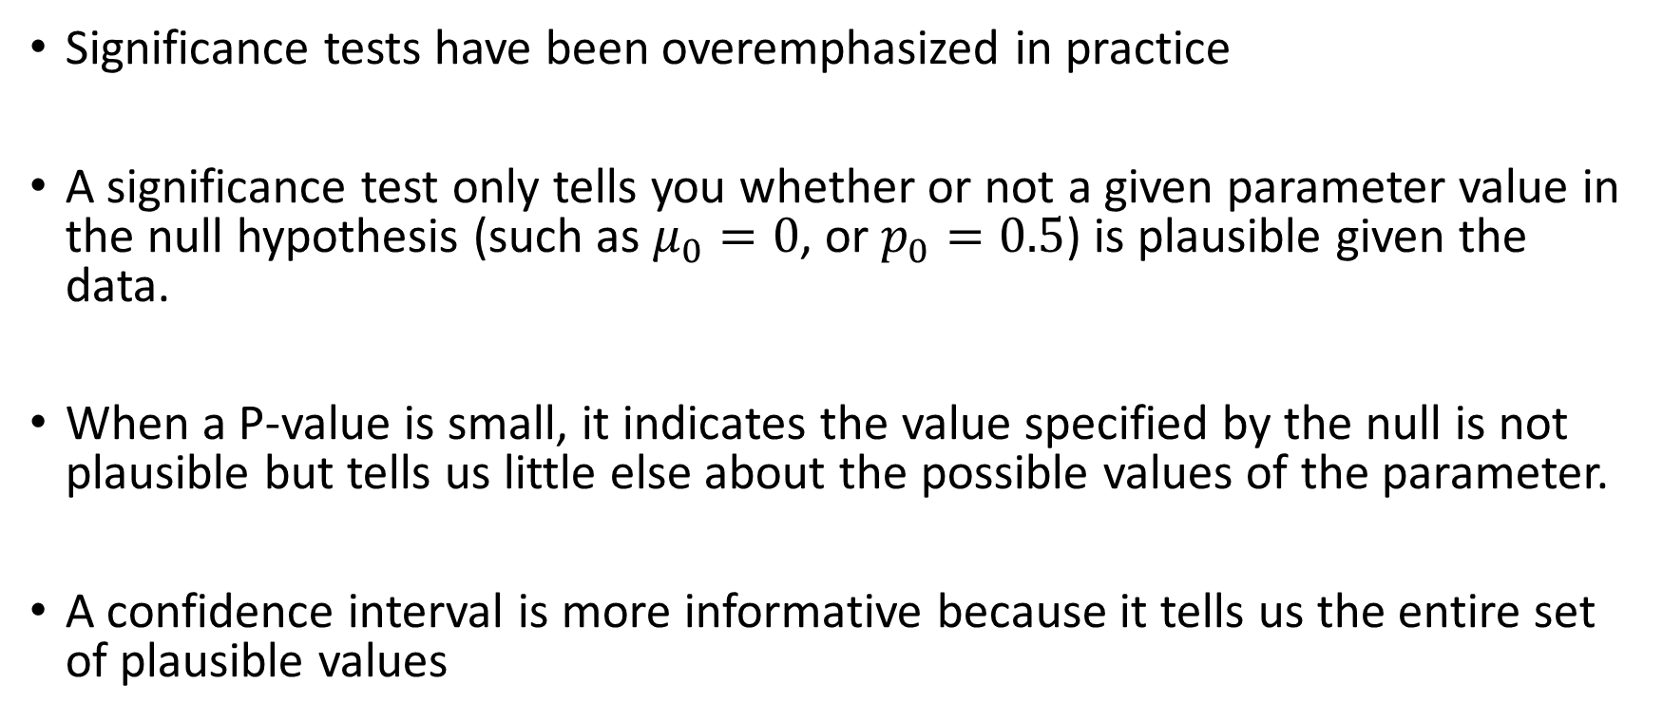
Significance tests are less useful than confidence intervals
Significance tests have been overemphasized in practice
A significance test only tells you whether or not a given parameter value in the null hypothesis (such as $μ_{0}=0$, or $p_{0}=0.5$) is plausible given the data.
When a P-value is small, it indicates the value specified by the null is not plausible but tells us little else about the possible values of the parameter.
A confidence interval is more informative because it tells us the entire set of plausible values

